Slide 1
Process Scheduling
Session 19 & 20
SESSION OUTCOME :
understand and explore the design of process scheduling: Fair Share Scheduler, Real-Time Processing
Understand system calls for time, clock, and console

Slide 2
Multiplexing
A process does I/O, put it to sleep, and schedule another process
Use timer interrupts to stop running on a processor after a fixed time quantum (100 msec)
Implementing multiplexing has a few challenges.
First, how to switch from one process to another?
Second, how to do context switching transparently?
Third, many CPUs may be switching among processes concurrently, and a locking plan is necessary to avoid races.
Fourth, when a process has exited its memory and otherresources must be freed, but it cannot do all of this itself because (for example) it can’tfree its own kernel stack while still using it.
Xv6 uses the standard mechanism of context switching

Slide 3

Context Switching
At a low level, xv6 performs two kinds of context switches:
from a process’s kernel thread to the current CPU’s scheduler thread,
and from the scheduler thread to a process’s kernel thread.
xv6 never directly switches from one user-space process to another; this happens by way of
a user-kernel transition (system call or interrupt),
a context switch to the scheduler,
a context switch to a new process’s kernel thread,
and a trap return.
Mechanics of switching between a kernel thread and a scheduler thread:
Every xv6 process has its own kernel stack and register set.
Each CPU has a separate scheduler thread for use when it is executing the scheduler rather than any process’s kernel thread.
Switching from one thread to another involves saving the old thread’s CPU registers, and restoring previously-saved registers of the new thread.
When it is time for the process to give up the CPU, the process’s kernel thread will call swtch to save its own context and return to the scheduler context.
At the end of each interrupt is that trap calls yield. Yield in turn calls sched, which calls swtch to save the current context in proc->context and switch to the scheduler context previously saved in cpu->scheduler.

Slide 4
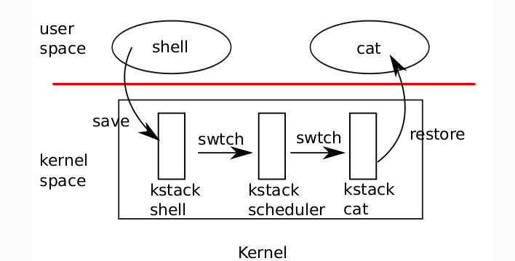
Context Switching

Slide 5
Context Switch Continuation ……
3471 // Force process to give up CPU on clock tick.
3472 // If interrupts were on while locks held, would need to check nlock.
3473 if(myproc() && myproc()−>state == RUNNING &&
3474 tf−>trapno == T_IRQ0+IRQ_TIMER)
3475 yield();
Let's dig into what yield() is doing (proc.c):
2826 // Give up the CPU for one scheduling round.
2827 void
2828 yield(void)
2829 {
2830 acquire(&ptable.lock);
2831 myproc()−>state = RUNNABLE;
2832 sched();
2833 release(&ptable.lock);
2834 }
Acquire a lock on the process table. This is to avoid race conditions when multiple processors are running scheduling code. Then we set the current process's state to RUNNABLE, and we call a function called sched() (in proc.c):

Slide 6
sched()
Verifies and ensures whether it is safe to schedule a new process.
First it checks that we're holding the process table lock,
then it checks to make sure we're only one pushcli() level deep,
then it makes sure the process being swapped off is not still running,
then it checks if interrupts have been cleared.
The last check feels a lot like a "just in case", because in theory the cpu->ncli check should cover it.
If any of the above is true, we cannot safely schedule a new process and the kernel panics.
The cpu->intena is a variable that stores whether or not interrupts were enabled before a pushcli call. The only place in the xv6 code that cpu->intena used in spinlock.c
panic is the kernel's last resort: the impossible has happened and the kernel does not know how to proceed.
2800 // Enter scheduler. Must hold only ptable.lock
2801 // and have changed proc−>state. Saves and restores
2802 // intena because intena is a property of this
2803 // kernel thread, not this CPU. It should
2804 // be proc−>intena and proc−>ncli, but that would
2805 // break in the few places where a lock is held but
2806 // there’s no process.
2807 void
2808 sched(void)
2809 {
2810 int intena;
2811 struct proc *p = myproc();
2812
2813 if(!holding(&ptable.lock)) // If we aren't holding the ptable lock, panic
2814 panic("sched ptable.lock");
2815 if(mycpu()−>ncli != 1) // If we aren't 1 pushcli level deep, panic
2816 panic("sched locks");
2817 if(p−>state == RUNNING) // If the current p is in the run state, panic
2818 panic("sched running");
2819 if(readeflags()&FL_IF) // If the processor can be interrupted, panic
2820 panic("sched interruptible");
2821 intena = mycpu()−>intena;
2822 swtch(&p−>context, mycpu()−>scheduler);
2823 mycpu()−>intena = intena;
2824 }

Slide 7
swtch()
swtch() takes two context structs, that look like this (proc.h):
It contains only the registers necessary for performing a context switch, and you can see in swtch() that all we need to do is push the current context values, switch the stack pointer, then pop the context values from the new stack into the appropriate registers.
The rest of the process is less concerned with context switching and more concerned with picking a new process to run.
2316 // Saved registers for kernel context switches.
2317 // Don’t need to save all the segment registers (%cs, etc),
2318 // because they are constant across kernel contexts.
2319 // Don’t need to save %eax, %ecx, %edx, because the
2320 // x86 convention is that the caller has saved them.
2321 // Contexts are stored at the bottom of the stack they
2322 // describe; the stack pointer is the address of the context.
2323 // The layout of the context matches the layout of the stack in swtch.S
2324 // at the "Switch stacks" comment. Switch doesn’t save eip explicitly,
2325 // but it is on the stack and allocproc() manipulates it.
2326 struct context {
2327 uint edi;
2328 uint esi;
2329 uint ebx;
2330 uint ebp;
2331 uint eip;
2332 };

Slide 8
swtch()
Each context is represented by a struct context*, a pointer to a structure stored on the kernel stack involved. swtch takes two arguments: struct context **old and struct context *new. It pushes the current CPU register onto the stack and saves the stack pointer in *old.
Each time a process has to give up the CPU, its kernel thread invokes swtch to save its own context and switch to the scheduler context.
void swtch(struct context**, struct context*);
Saves and restores contexts
Takes two arguments: struct context **old and struct context *new
Replaces the former with the latter
Each time a process has to give up the CPU, its kernel thread invokes swtch to save its own context and switch to the scheduler context
Context is a struct context*, stored on the kernel stack
CPU pushed onto stack and saves stack pointer to *old
Copies new to %esp, pops previous registers, and returns

Slide 9
3050 # Context switch
3051 #
3052 # void swtch(struct context **old, struct context *new);
3053 #
3054 # Save the current registers on the stack, creating
3055 # a struct context, and save its address in *old.
3056 # Switch stacks to new and pop previously−saved registers.
3057
3058 .globl swtch
3059 swtch:
3060 movl 4(%esp), %eax
3061 movl 8(%esp), %edx
3062
3063 # Save old callee−saved registers
3064 pushl %ebp
3065 pushl %ebx
3066 pushl %esi
3067 pushl %edi
3068
3069 # Switch stacks
3070 movl %esp, (%eax)
3071 movl %edx, %esp
3072
3073 # Load new callee−saved registers
3074 popl %edi
3075 popl %esi
3076 popl %ebx
3077 popl %ebp
3078 ret
The next important call inside of sched() is the call to swtch(). This is the central/key of the operation, where the actual context switching happens. It passes in a pointer to the current process's context, so that the current registers can be saved, and it passes in the scheduler's context to be switched to. It makes sense, in that case, that this part is implemented in assembler (swtch.S):

Slide 10
Scheduler
Simple loop: find a process to run, run it until it stops, repeat
Acquires and releases ptable.lock, and enables interrupts on every iteration.
If CPU is idle (no RUNNABLE) 1 Idle looping while holding a lock would not allow any other CPU to access the process table 2 Idle looping (all processes are waiting for I/O) while interrupts are disabled would not allow any I/O to arrive
The first process with p->state == RUNNABLE is selected
The process is assigned to the per-CPU proc
The process’s page table is switched to via switchuvm
The process is marked as RUNNING
swtch is called to start running it

Slide 11
Scheduler
2768 // Loop over process table looking for process to run.
2769 acquire(&ptable.lock);
2770 for(p = ptable.proc; p < &ptable.proc[NPROC]; p++){
2771 if(p−>state != RUNNABLE)
2772 continue;
2773
2774 // Switch to chosen process. It is the process’s job
2775 // to release ptable.lock and then reacquire it
2776 // before jumping back to us.
2777 c−>proc = p;
2778 switchuvm(p);
2779 p−>state = RUNNING;
2780
2781 swtch(&(c−>scheduler), p−>context);
2782 switchkvm();
2783
2784 // Process is done running for now.
2785 // It should have changed its p−>state before coming back.
2786 c−>proc = 0;
2787 }
2788 release(&ptable.lock);
2789
2790 }
2791 }
2750 // Per−CPU process scheduler.
2751 // Each CPU calls scheduler() after setting itself up.
2752 // Scheduler never returns. It loops, doing:
2753 // − choose a process to run
2754 // − swtch to start running that process
2755 // − eventually that process transfers control
2756 // via swtch back to the scheduler.
2757 void
2758 scheduler(void)
2759 {
2760 struct proc *p;
2761 struct cpu *c = mycpu();
2762 c−>proc = 0;
2763
2764 for(;;){
2765 // Enable interrupts on this processor.
2766 sti();
2767

Slide 12
mycpu and myproc
xv6 maintains a struct cpu for each processor, which records the process currently running on the processor (if any), the processor’s unique hardware identifier (apicid), and some other information.
The function mycpu returns the current processor’s struct cpu. mycpu does this by reading the processor identifier from the local APIC hardware and looking through the array of struct cpu for an entry with that identifier. The return value of mycpu is fragile: if the timer were to interrupt and cause the thread to be moved to a different processor, the return value would no longer be correct. To avoid this problem, xv6 requires that callers of mycpu disable interrupts, and only enable them after they finish using the returned struct cpu.
The function myproc returns the struct proc pointer for the process that is running on the current processor. myproc disables interrupts, invokes mycpu, fetches the current process pointer (c->proc) out of the struct cpu, and then enables interrupts. If there is no process running, because the the caller is executing in scheduler, myproc returns zero. The return value of myproc is safe to use even if interrupts are enabled: if a timer interrupt moves the calling process to a different processor, its struct proc pointer will stay the same.

Slide 13
2434 // Must be called with interrupts disabled to avoid the caller being
2435 // rescheduled between reading lapicid and running through the loop.
2436 struct cpu*
2437 mycpu(void)
2438 {
2439 int apicid, i;
2440
2441 if(readeflags()&FL_IF)
2442 panic("mycpu called with interrupts enabled\n");
2443
2444 apicid = lapicid();
2445 // APIC IDs are not guaranteed to be contiguous. Maybe we should have
2446 // a reverse map, or reserve a register to store &cpus[i].
2447 for (i = 0; i < ncpu; ++i) {
2448 if (cpus[i].apicid == apicid)
2449 return &cpus[i];
2450 }
2451 panic("unknown apicid\n");
2452 }

Slide 14
2454 // Disable interrupts so that we are not rescheduled
2455 // while reading proc from the cpu structure
2456 struct proc*
2457 myproc(void) {
2458 struct cpu *c;
2459 struct proc *p;
2460 pushcli();
2461 c = mycpu();
2462 p = c−>proc;
2463 popcli();
2464 return p;
2465 }

Slide 15
Fair Share Scheduler
In fair share scheduling, there are groups of processes and the time quantum is allocated equally to all the groups, even if number of processes in each group might be different.
For example, if there are 4 fair share groups with 1, 2, 3, and 4 processes respectively, then the one process in group 1 will get twice time quantum than a process in group 2, thrice than a process in group 3 and four times than a process in group 4.
To implement this scheme, another field is added in the u-area for "fair share group priority". It is shared by all the processes in the same fair share group. The clock interrupt handler increments the fair share group CPU usage field for the running process, just as it increments the CPU usage field of the running process and decays the values of all fair share group CPU usage fields once a second. When calculating priorities, a new component of the calculation is the group CPU usage, normalized according to the amount of CPU time allocated to the fair share group.

Slide 16
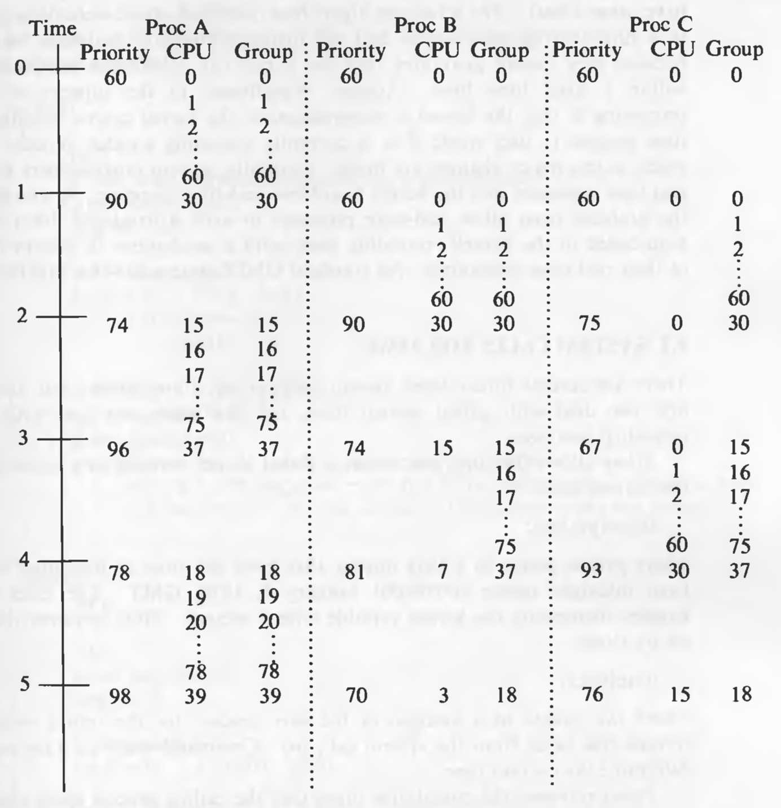
For example, consider the processes in the following diagram:
Process A belongs to one group and processes B and C belong to another group. Therefore, the "group" value is shared between B and C. The priorities will be calculated by this formula :
priority = (CPU usage / 2) + (Group CPU usage / 2) + base priority
That is why processes execute in this manner: A, B, A, C, A, B, A, C, and so on...

Slide 17
Real Time Processing
Real time processing is usually found in systems that use computer control.
This processing method is used when it is essential that the input request is dealt with quickly enough so as to be able to control an output properly.
For example, the computer inside the Engine Control Unit in a car has to manage the engine at every moment based on what the driver wants to do.
Note that real-time processing does not have to be 'fast'.
For example, a traffic light system is a real-time system but it only needs to process data relatively slowly. On the other hand, controlling a car engine has to deal with input events happening every thousandth of a second so a very fast computer is needed to do this -but both the traffic-light and the car engine computers are carrying out 'real-time' processing.
Examples:
Traffic lights
Heart rate monitoring
Aircraft control
Computer games
Controlling robots
The user interface of a real-time system may use specialist input devices to provide data input
For example, a car driver will be providing input data to the onboard computer with throttle and brake pedals. A gamer may be using a joystick or hand held control to interact with the real-time game. A traffic light system may sense the car at the lights using a buried inductive loop.

Slide 18
System Calls for Time
There are several time-related system calls
stime
time
times
alarm
The first two deal with global system time, and the latter two deal with time for individual processes
stime allows the suepruser to set a global kernel variable to a value that gives the current time:
stime(pvalue)
where pvalue points to a long integer that gives the time as measured in seconds from midnight before (00:00:00) January 1, 1970, GMT. The clock interrupt handler increments the kernel variable once a second.

Slide 19
System Calls for Time
time retrieves the time as set by stime.
time(tloc)
where tloc points to a location in the user process for the return value. time returns this value from the system call, too.
times
times retrieves the cumulative times that the calling process spent executing in user mode and kernel mode and the cumulative times that all zombie children had executed in user mode and kernel mode.
times returns the elapsed time "from an arbitrary point in the past", usually the time of system boot and fills tbuffer with accounting information.
struct tms *tbuffer;
times(tbuffer);
where the structure tms contains the retrieved times, and is defined by:
struct tms {
// time_t is the data structure for time
time_t tims_utime; // user time of process
time_t tm_ stime; // kernel time of process
time_t tms_cutime; // user time of children
time_t tms_cstime; // kernel time of children
}

Slide 20
System Calls for Time
The program forks 10 children and uses times to get the time related statistics:
One would naively expect the parent
child user and child system times to equal the respective sums of the child processes' user and system times, and the parent real time to equal the sum of the child processes' real time.
However, child times do not include times spent in the fork and exit system calls, and all times can be distorted by time spent handling interrupts or doing context switches.
alarm: User processes can schedule alarm signals using the alarm system call.
alarm
unsigned alarm (seconds)
unsigned seconds;
Alarm schedules the occurrence of an alarm signal for the calling process in the indicated number of seconds. It returns the amount of time remaining until the alarm signal at the time of the call.

Slide 21
Clock
The functions of the clock interrupt handler are to:
restart the clock
schedule invocation of internal kernel functions based on internal timers
provide execution profiling capability for the kernel and for user processes
gather system and process accounting statistics,
keep track of time
send alarm signals to processes on request
periodically wake up the swapper process
control process scheduling
Some operations are done every clock interrupt, whereas others are done after several clock ticks. The clock handler runs with processor execution level set high.

Slide 22
Advanced Programmable Interrupt Controller (APIC)
In the multiprocessor PC boards, each CPU needs an interrupt controller to handle interrupts sent to it, and there must be a method for routing interrupts to processors.
This Comprises of two components
a part that is attached to each processor
(the local APIC, lapic.c)- (LAPIC)
a part that is in the I/O system
(the IO APIC, ioapic.c) - (IOAPIC)
Xv6 is designed for a board with multiple processors: it ignores interrupts
from the PIC, and configures the IOAPIC and local APIC
Three devices turn on interrupts in xv6
UART (uart.c)
IDE (ide.c)
Keyboard (console.c)
The timer chip is inside the LAPIC, so that each processor can receive timer interrupts independently. Xv6 sets it up in lapicinit.
0324 // lapic.c
0325 void cmostime(struct rtcdate *r);
0326 int lapicid(void);
0327 extern volatile uint* lapic;
0328 void lapiceoi(void);
0329 void lapicinit(void);
0330 void lapicstartap(uchar, uint);
0331 void microdelay(int);
0310 // ioapic.c
0311 void ioapicenable(int irq, int cpu);
0312 extern uchar ioapicid;
0313 void ioapicinit(void);
3835 // return how many clock tick
3836 // interrupts have occurred since start.
3837 int
3838 sys_uptime(void)
3839 {
3840 uint xticks;
3841
3842 acquire(&tickslock);
3843 xticks = ticks;
3844 release(&tickslock);
3845 return xticks;
3846 } Source : from xv6 sysproc.c
xv6/defs.h
0410
0411 // timer.c
0412 void timerinit(void);
0413

Slide 23
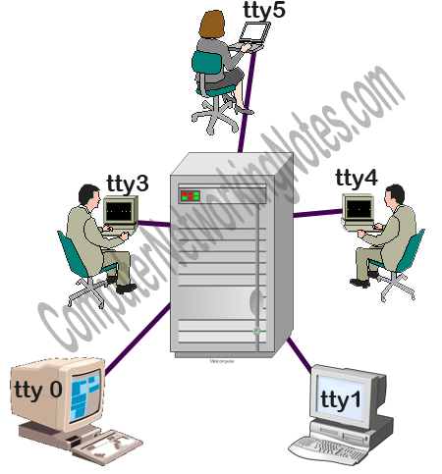
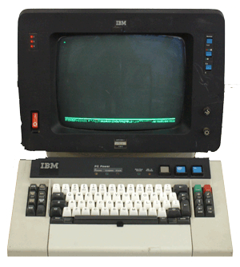
Console
Linux Virtual Console and Terminal :
Virtual consoles and terminals allow multiple users to login and access a Linux system simultaneously.
To understand the Linux virtual console concept, we have to look back in the history of computers.
In earlier days, computers used to be very expensive. Instead of personal computers, companies used to prefer mainframe computers.
A mainframe computer allows multiple users to connect with it separately. In mainframe computing, every user accesses the mainframe computer as a separate computer.
A device known as terminal which contains only few parts and a monitor with integrated keyboard is used to access the mainframe computer. The earliest terminals were also known as teletypes (abbreviated TTY).

Slide 24
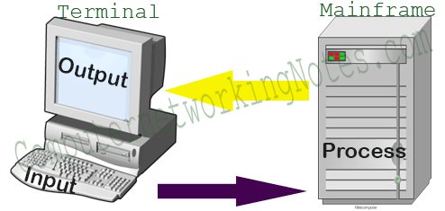
Console
Terminal connects with mainframe computer on serial console port. Once connected, it uses all resources such as CPU, RAM and Hard disk from mainframe computer.
Since a terminal directly communicates with system at low level on dedicated serial console port, it does not need any special service, software or application to run. When you booted up the terminal, you would see a login prompt called Linux console on monitor.
In terminal, Linux console is the only place where you can enter commands for system. Linux operating system installed in mainframe computer emulates each console as a separate system with a separate login session.
Over the time, technology improved and we have personal computers.
Personal computers have all necessary resources for os and also easier to setup and manage.
Since PCs have all necessary resource for os companies preferred to install an individual os in each PC. Gradually terminals became outdated and replaced by PCs.
Even though terminals are history now, terminal concept still exists in Linux operating system. A Linux operating system not only have necessary software configuration that allows physical terminals to connect with it but also offers a way to access that software configuration virtually. That way is known as virtual console.

Slide 25
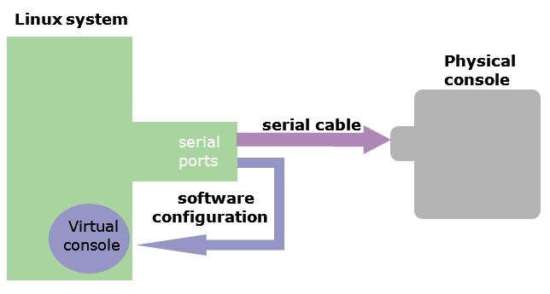
Console
Physical console: - A physical terminal device connected with Linux system on serial port via serial cable physically.
Virtual console: - An application that simulates a physical terminal device in software and connects it with Linux system on serial port through software configuration virtually.
Physical terminal device: - A physical device that consisted of nothing more than a monitor and keyboard attached to it. It uses all resources such as CPU, RAM and Hard disk from server system.
Virtual terminal application: - An application that provides a text based environment to access the shell. Since physical terminals are no longer used, it became common practice to use the word terminal to refer the virtual terminal application.
The word virtual console refers to an application that simulates a physical terminal while the word terminal refers to an application that allows us to access and use the shell.

Slide 26
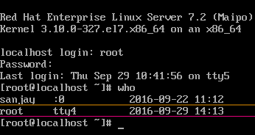
How to access virtual console
Virtual consoles can be accessed by holding the Ctrl and Alt keys and pressing a function key between F1 and F6. Let’s take an example.
Hold down the Ctrl + Alt keys, and press F4 to access a virtual console. In virtual console, login from user root and run who command.
The who command lists the currently logged in users along with the console number where they are logged in.
When you are finished, you can use exit command to logout from virtual console.
Switching between virtual consoles
You can cycle through virtual consoles using the Crtl+Alt+F1 to F7 keys. Switching does not terminate the active login session. Each virtual console is independent and separate.
To switch between virtual consoles or to return back in GUI from virtual console, you may use only Alt+F(1,2,3,4,5,6) keys. While switching between virtual consoles or accessing GUI from virtual console, Ctrl key is optional. It is required only when accessing virtual console from GUI.
0268 // console.c
0269 void consoleinit(void);
0270 void cprintf(char*, ...);
0271 void consoleintr(int(*)(void));
0272 void panic(char*) __attribute__((noreturn));

Slide 27
Summary of CO2
S.No | Topic Name | Algorithms Learned | Xv6 functions
11 | Process overview | Processes, States and Transitions Process & kernel data structures | struct proc in proc.h
12 | The System Call | Algorithms for inthand, syscall, | usys.s, tvinit, mpmain(), alltraps, traps, syscall()
13 | Saving the context of a process | Algorithms for Context Switch, Copying Data between System and User Address space | trap.c, trapasm.s, syscal.c, swtch.s
14 | sleep and wakeup algorithms | Design of sleep, sys_sleep, wakeup, wakeup1 | proc.c, sysproc.c , spinlock.c,
15 | Process control system calls | Design of Algorithms for fork, kill, exit | fork, kill, exit in proc.c
16 | Process control system calls | Design of Algorithms for exec, shell, init process | exec.c, sysfile.c, sh.c, init.c
17 | Design of process scheduling | Multiplexing, mycpu and myproc. Schedule process | proc.c, swtch.s
18 | Design of process scheduling | Scheduling Parameters, Controlling Process Priorities | Swtch(), yield(), sched()
19 | Design of process scheduling | Fair Share Scheduler, Real-Time Processing | mycpu, myproc, scheduler
20 | System calls for time, clock, and console | Understand console. Algorithms for stime, time, times, and alarm, clock | lapic.c, sysproc.c, defs.h,timer.c, console.c

Slide 28
Thank You

